Slide 1


Slide 2
Overview
Hadoop is a framework for running applications on large clusters built of commodity hardware. The Hadoop framework transparently provides applications both reliability and data motion. Hadoop implements a computational paradigm named Map/Reduce, where the application is divided into many small fragments of work, each of which may be executed or re-executed on any node in the cluster. In addition, it provides a distributed file system (HDFS) that stores data on the compute nodes, providing very high aggregate bandwidth across the cluster. Both Map/Reduce and the distributed file system are designed so that node failures are automatically handled by the framework Hadoop wiki

Slide 3
HDFS
Hadoop's Distributed File System is designed to reliably store very large files across machines in a large cluster. It is inspired by the Google File System. Hadoop DFS stores each file as a sequence of blocks, all blocks in a file except the last block are the same size. Blocks belonging to a file are replicated for fault tolerance. The block size and replication factor are configurable per file. Files in HDFS are "write once" and have strictly one writer at any time.
Hadoop Distributed File System – Goals:
Store large data sets
Cope with hardware failure
Emphasize streaming data access

Slide 4
Map Reduce
The Hadoop Map/Reduce framework harnesses a cluster of machines and executes user defined Map/Reduce jobs across the nodes in the cluster. A Map/Reduce computation has two phases, a map phase and a reduce phase. The input to the computation is a data set of key/value pairs.
Tasks in each phase are executed in a fault-tolerant manner, if node(s) fail in the middle of a computation the tasks assigned to them are re-distributed among the remaining nodes. Having many map and reduce tasks enables good load balancing and allows failed tasks to be re-run with small runtime overhead.
Hadoop Map/Reduce – Goals:
• Process large data sets
• Cope with hardware failure
• High throughput
http://labs.google.com/papers/mapreduce.html

Slide 5
Architecture
Like Hadoop Map/Reduce, HDFS follows a master/slave architecture. An HDFS installation consists of a single Namenode, a master server that manages the filesystem namespace and regulates access to files by clients. In addition, there are a number of Datanodes, one per node in the cluster, which manage storage attached to the nodes that they run on. The Namenode makes filesystem namespace operations like opening, closing, renaming etc. of files and directories available via an RPC interface. It also determines the mapping of blocks to Datanodes. The Datanodes are responsible for serving read and write requests from filesystem clients, they also perform block creation, deletion, and replication upon instruction from the Namenode.

Slide 6
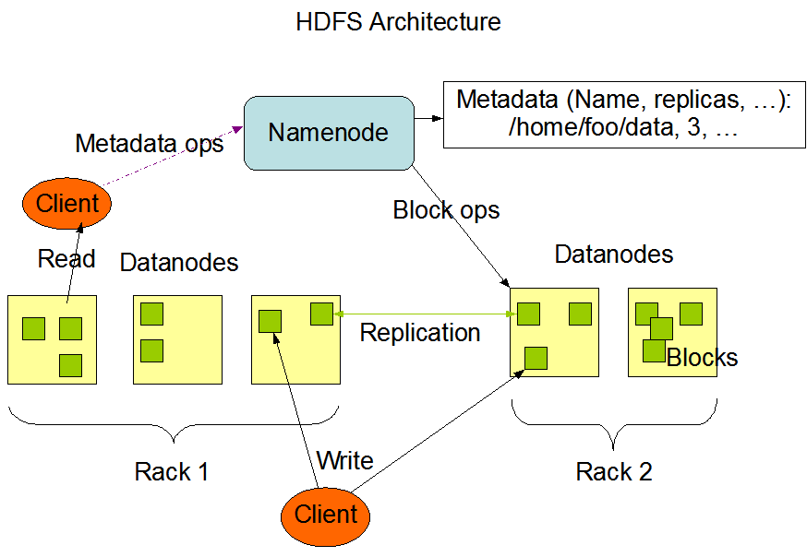
Architecture

Slide 7
Downloading and installing Hadoop
Hadoop can be downloaded from one of the Apache download mirrors. Select a directory to install Hadoop under (let's say /foo/bar/hadoop-install) and untar the tarball in that directory. A directory corresponding to the version of Hadoop downloaded will be created under the /foo/bar/hadoop-install directory. For instance, if version 0.6.0 of Hadoop was downloaded untarring as described above will create the directory /foo/bar/hadoop-install/hadoop-0.6.0. The examples in this document assume the existence of an environment variable $HADOOP_INSTALL that represents the path to all versions of Hadoop installed. In the above instance HADOOP_INSTALL=/foo/bar/hadoop-install. They further assume the existence of a symlink named hadoop in $HADOOP_INSTALL that points to the version of Hadoop being used. For instance, if version 0.6.0 is being used then $HADOOP_INSTALL/hadoop -> hadoop-0.6.0. All tools used to run Hadoop will be present in the directory $HADOOP_INSTALL/hadoop/bin. All configuration files for Hadoop will be present in the directory $HADOOP_INSTALL/hadoop/conf

Slide 8
Single-node setup of Hadoop

Slide 9
Configurations
Files to configure:
hadoop-env.sh
Open the file <HADOOP_INSTALL>/conf/hadoop-env.sh in the editor of your choice and set the JAVA_HOME environment variable to the Sun JDK/JRE 1.5.0 directory.
-------------------------------------------------------------------
# The java implementation to use. Required.
# export JAVA_HOME=/usr/lib/j2sdk1.5-sun
-----------------------------------------------------------
hadoop-site.xml
Any site-specific configuration of Hadoop is configured in <HADOOP_INSTALL>/conf/hadoop-site.xml. Here we will configure the directory where Hadoop will store its data files, the ports it listens to, etc.
You can leave the settings below as is with the exception of the hadoop.tmp.dir variable which you have to change to the directory of your choice, for example /usr/local/hadoop-datastore/hadoop-${user.name}.
--------------------------------------------------------------------
<property>
<name>hadoop.tmp.dir</name>
<value>/your/path/to/hadoop/tmp/dir/hadoop-${user.name}</value>
<description>A base for other temporary directories.</description>
</property>
----------------------------------------------------------------------

Slide 10
Starting the single-node cluster
Formatting the name node:
The first step to starting up your Hadoop installation is formatting the Hadoop file system which is implemented on top of the local file system of your "cluster“. You need to do this the first time you set up a Hadoop cluster. cluster. Do not format a running Hadoop filesystem, this will cause all your data to be erased.
run the command :
hadoop@ubuntu:~$ <HADOOP_INSTALL>/hadoop/bin/hadoop namenode –format
Starting cluster:
This will startup a Namenode, Datanode, Jobtracker and a Tasktracker .
Run the command:
hadoop@ubuntu:~$ <HADOOP_INSTALL>/bin/start-all.sh
Stopping cluster:
To stop all the daemons running on your machine,
run the command:
hadoop@ubuntu:~$ <HADOOP_INSTALL>/bin/stop-all.sh

Slide 11
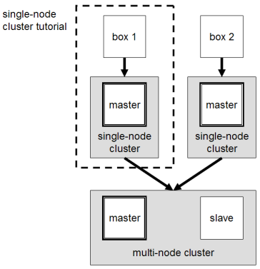
Multi-Node setup on Hadoop
We will build a multi-node cluster using two Ubuntu boxes in this tutorial. The best way to do this is to install, configure and test a "local" Hadoop setup for each of the two Ubuntu boxes, and in a second step to "merge" these two single-node clusters into one multi-node cluster in which one Ubuntu box will become the designated master (but also act as a slave with regard to data storage and processing), and the other box will become only a slave. The master node will run the "master" daemons for each layer: namenode for the HDFS storage layer, and jobtracker for the MapReduce processing layer. Both machines will run the "slave" daemons: datanode for the HDFS layer, and tasktracker for MapReduce processing layer. Basically, the "master" daemons are responsible for coordination and management of the "slave" daemons while the latter will do the actual data storage and data processing work. It's recommended to use the same settings (e.g., installation locations and paths) on both machines.

Slide 12
Configurations
Now we will modify the Hadoop configuration to make one Ubuntu box the master (which will also act as a slave) and the other Ubuntu box a slave.
We will call the designated master machine just the master from now and the slave-only machine the slave.
Both machines must be able to reach each other over the network
Shutdown each single-node cluster with <HADOOP_INSTALL>/bin/stop-all.sh before continuing if you haven't done so already.

Slide 13
Configurations
Files to configure:
conf/masters (master only)
The conf/masters file defines the master nodes of our multi-node cluster. In our case, this is just the master machine.
On master, update <HADOOP_INSTALL>/conf/masters that it looks like this:
----------------------
master
---------------------
conf/slaves (master only)
This conf/slaves file lists the hosts, one per line, where the Hadoop slave daemons (datanodes and tasktrackers) will run. We want both the master box and the slave box to act as Hadoop slaves because we want both of them to store and process data.
On master, update <HADOOP_INSTALL>/conf/slaves that it looks like this:
------------------
Master
slave
-------------------
If you have additional slave nodes, just add them to the conf/slaves file, one per line.

Slide 14
Configurations
conf/hadoop-site.xml (all machines):
Assuming you configured conf/hadoop-site.xml on each machine as described in the single-node cluster tutorial, you will only have to change a few variables.
Important: You have to change conf/hadoop-site.xml on ALL machines as follows.
First, we have to change the fs.default.name variable which specifies the NameNode (the HDFS master) host and port. In our case, this is the master machine.
------------------------------------------
<property>
<name>fs.default.name</name>
<value>hdfs://master:54310</value>
<description>The name of the default file system. . .
</property>
---------------------------------------
Second, we have to change the mapred.job.tracker variable which specifies the JobTracker (MapReduce master) host and port. Again, this is the master in our case.
-------------------------------------------------------
<property>
<name>mapred.job.tracker</name>
<value>master:54311</value>
<description>The host and port that the MapReduce job tracker runs at . . . </description>
</property>
-------------------------------------------------

Slide 15
Configurations
Third, we change the dfs.replication variable which specifies the default block replication. It defines how many machines a single file should be replicated to before it becomes available. If you set this to a value higher than the number of slave nodes that you have available, you will start seeing a lot of type errors in the log files.
---------------------------------
<property>
<name>dfs.replication</name>
<value>2</value>
<description>Default block replication. . .</description>
</property>
----------------------------------
Additional settings:
conf/hadoop-site.xml
You can change the mapred.local.dir variable which determines where temporary MapReduce data is written. It also may be a list of directories.

Slide 16
Starting the multi-node cluster
:Formatting the namenode
Before we start our new multi-node cluster, we have to format Hadoop's distributed filesystem (HDFS) for the namenode. You need to do this the first time you set up a Hadoop cluster. Do not format a running Hadoop namenode, this will cause all your data in the HDFS filesytem to be erased.
To format the filesystem (which simply initializes the directory specified by the dfs.name.dir variable on the namenode), run the command (from the master):
--------------------------------------------
bin/hadoop namenode -format
---------------------------------------------
Starting the multi-node cluster:
Starting the cluster is done in two steps. First, the HDFS daemons are started: the namenode daemon is started on master, and datanode daemons are started on all slaves (here: master and slave). Second, the MapReduce daemons are started: the jobtracker is started on master, and tasktracker daemons are started on all slaves (here: master and slave).

Slide 17
Starting the multi-node cluster
HDFS daemons:
Run the command <HADOOP_INSTALL>/bin/start-dfs.sh on the machine you want the namenode to run on. This will bring up HDFS with the namenode running on the machine you ran the previous command on, and datanodes on the machines listed in the conf/slaves file.
In our case, we will run bin/start-dfs.sh on master:
-------------------------
bin/start-dfs.sh
---------------------------
On slave, you can examine the success or failure of this command by inspecting the log file <HADOOP_INSTALL>/logs/hadoop-hadoop-datanode-slave.log.
At this point, the following Java processes should run on master:
-----------------------------------
hadoop@master:/usr/local/hadoop$ jps
14799 NameNode
15314 Jps
14880 DataNode
14977 SecondaryNameNode
------------------------------------

Slide 18
Starting the multi-node cluster
and the following Java processes should run on slave:
--------------------------------------
hadoop@slave:/usr/local/hadoop$ jps
15183 DataNode
15616 Jps
---------------------------------------
MapReduce daemons:
Run the command <HADOOP_INSTALL>/bin/start-mapred.sh on the machine you want the jobtracker to run on. This will bring up the MapReduce cluster with the jobtracker running on the machine you ran the previous command on, and tasktrackers on the machines listed in the conf/slaves file.
In our case, we will run bin/start-mapred.sh on master:
-------------------------------------
bin/start-mapred.sh
-------------------------------------
On slave, you can examine the success or failure of this command by inspecting the log file <HADOOP_INSTALL>/logs/hadoop-hadoop-tasktracker-slave.log.

Slide 19
Starting the multi-node cluster
At this point, the following Java processes should run on master:
----------------------------------------------------
hadoop@master:/usr/local/hadoop$ jps
16017 Jps
14799 NameNode
15686 TaskTracker
14880 DataNode
15596 JobTracker
14977 SecondaryNameNode
----------------------------------------------------
And the following Java processes should run on slave:
---------------------------------------
hadoop@slave:/usr/local/hadoop$ jps
15183 DataNode
15897 TaskTracker
16284 Jps
-------------------------------------------

Slide 20
Stopping the multi-node cluster
First, we begin with stopping the MapReduce daemons: the jobtracker is stopped on master, and tasktracker daemons are stopped on all slaves (here: master and slave). Second, the HDFS daemons are stopped: the namenode daemon is stopped on master, and datanode daemons are stopped on all slaves (here: master and slave).
MapReduce daemons:
Run the command <HADOOP_INSTALL>/bin/stop-mapred.sh on the jobtracker machine. This will shut down the MapReduce cluster by stopping the jobtracker daemon running on the machine you ran the previous command on, and tasktrackers on the machines listed in the conf/slaves file.
In our case, we will run bin/stop-mapred.sh on master:
-------------------------------
bin/stop-mapred.sh
-------------------------------
At this point, the following Java processes should run on master:
--------------------------------------
hadoop@master:/usr/local/hadoop$ jps
14799 NameNode
18386 Jps
14880 DataNode
14977 SecondaryNameNode
--------------------------------------------

Slide 21
Stopping the multi-node cluster
And the following Java processes should run on slave:
-------------------------------
hadoop@slave:/usr/local/hadoop$ jps
15183 DataNode
18636 Jps
--------------------------------
HDFS daemons:
Run the command <HADOOP_INSTALL>/bin/stop-dfs.sh on the namenode machine. This will shut down HDFS by stopping the namenode daemon running on the machine you ran the previous command on, and datanodes on the machines listed in the conf/slaves file.
In our case, we will run bin/stop-dfs.sh on master:
---------------------------------
bin/stop-dfs.sh
---------------------------------
At this point, the only following Java processes should run on master:
-------------------------------
hadoop@master:/usr/local/hadoop$ jps
18670 Jps
------------------------------

Slide 22
Stopping the multi-node cluster
And the following Java processes should run on slave:
--------------------------------
hadoop@slave:/usr/local/hadoop$ jps
18894 Jps
--------------------------------

Slide 23
Running a MapReduce job
We will now run your first Hadoop MapReduce job. We will use the WordCount example job which reads text files and counts how often words occur. The input is text files and the output is text files, each line of which contains a word and the count of how often it occurred, separated by a tab.
Download example input data:
The Notebooks of Leonardo Da Vinci
Download the ebook as plain text file in us-ascii encoding and store the uncompressed file in a temporary directory of choice, for example /tmp/gutenberg.
Restart the Hadoop cluster
Restart your Hadoop cluster if it's not running already.
-------------------------
hadoop@ubuntu:~$ <HADOOP_INSTALL>/bin/start-all.sh
Copy local data file to HDFS
Before we run the actual MapReduce job, we first have to copy the files from our local file system to Hadoop's HDFS
-----------------------------
hadoop@ubuntu:/usr/local/hadoop$ bin/hadoop dfs -copyFromLocal /tmp/source destination

Slide 24
Running a MapReduce job
Run the MapReduce job
Now, we actually run the WordCount example job.
This command will read all the files in the HDFS “destination” directory , process it, and store the result in the HDFS directory “output”.
-----------------------------------------
hadoop@ubuntu:/usr/local/hadoop$ bin/hadoop hadoop-example wordcount destination output
-----------------------------------------
You can check if the result is successfully stored in HDFS directory “output”.
Retrieve the job result from HDFS
To inspect the file, you can copy it from HDFS to the local file system.
-------------------------------------
hadoop@ubuntu:/usr/local/hadoop$ mkdir /tmp/output
hadoop@ubuntu:/usr/local/hadoop$ bin/hadoop dfs –copyToLocal output/part-00000 /tmp/output
----------------------------------------
Alternatively, you can read the file directly from HDFS without copying it to the local file system by using the command :
---------------------------------------------
hadoop@ubuntu:/usr/local/hadoop$ bin/hadoop dfs –cat output/part-00000

Slide 25
Hadoop Web Interfaces
MapReduce Job Tracker Web Interface
The job tracker web UI provides information about general job statistics of the Hadoop cluster, running/completed/failed jobs and a job history log file. It also gives access to the local machine's Hadoop log files (the machine on which the web UI is running on).
By default, it's available at http://localhost:50030/
Task Tracker Web Interface
The task tracker web UI shows you running and non-running tasks. It also gives access to the local machine's Hadoop log files.
By default, it's available at http://localhost:50060/
HDFS Name Node Web Interface
The name node web UI shows you a cluster summary including information about total/remaining capacity, live and dead nodes. Additionally, it allows you to browse the HDFS namespace and view the contents of its files in the web browser. It also gives access to the local machine's Hadoop log files.
By default, it's available at http://localhost:50070/

Slide 26
Writing An Hadoop MapReduce Program
Even though the Hadoop framework is written in Java, programs for Hadoop need not to be coded in Java but can also be developed in other languages like Python or C++ (the latter since version 0.14.1).
Creating a launching program for your application
• The launching program configures:
– The Mapper and Reducer to use
– The output key and value types (input types are inferred from the InputFormat)‏
– The locations for your input and output
• The launching program then submits the job and typically waits for it to complete
A Map/Reduce may specify how it’s input is to be read by specifying an InputFormat to be used
A Map/Reduce may specify how it’s output is to be written by specifying an OutputFormat to be used

Slide 27
Bibliography
http://www.michael-noll.com/wiki/Running_Hadoop_On_Ubuntu_Linux_(Single-Node_Cluster)#Running_a_MapReduce_job
http://wiki.apache.org/hadoop/

